Slide 1
Level 2 Task 1
Raviraj mane

Slide 2
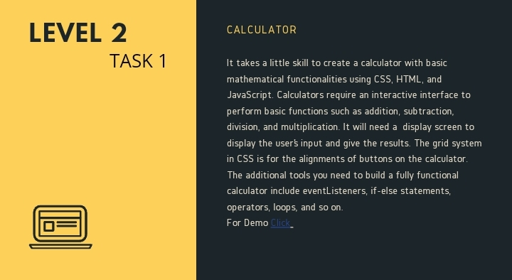

Slide 3
